Slide 1





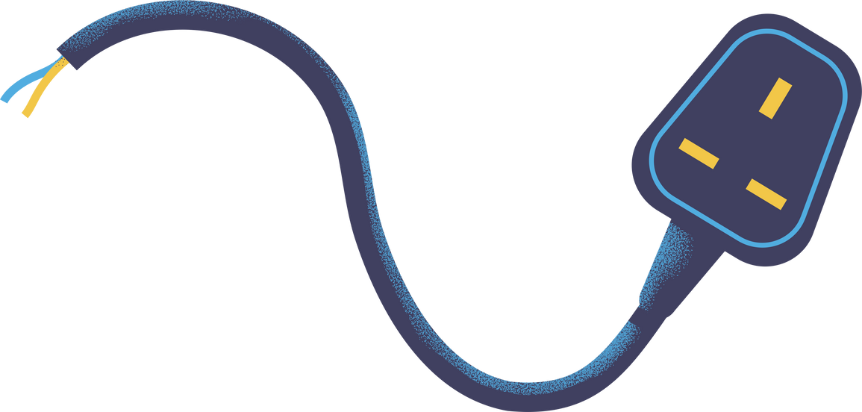

Electrician
Zamselco Electric Inc.

Slide 2

Mascot logo type

Slide 3

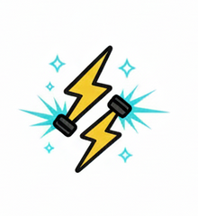

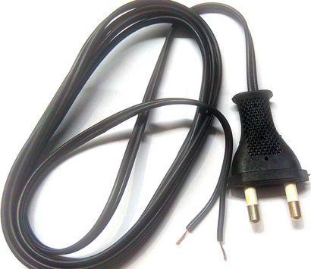
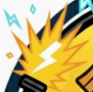
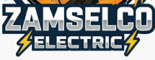
Symbols & Objects
Shown below are the use objects components and their corresponding symbols in the logo:
Zenitsu figure
Lightning Volts
open switch
wire
Spark
Company Name

Slide 4

Color Palette
Element | Color | HEX Code | Description
Yellow (Lightning & Outfit) | 🟨 | #F7C948 | Bright energy color representing electricity and power.
Orange (Background Glow) | 🟧 | #F5A623 | Warm and vibrant, symbolizes energy, optimism, and light.
Dark Blue (Outer Frame & Text) | 🔵 | #0E2B4A | Stands for stability, trust, and professionalism.
Light Blue (Electric Sparks) | 🟦 | #4ED0E2 | Represents modern energy flow and electric current.
White (Text Highlights) | ⚪ | #FFFFFF | Clean contrast for clarity and illumination.
Black (Outlines & Sword Handle) | ⚫ | #1C1C1C | Adds depth, structure, and visual strength.
Skin Tone (Character) | 🏽 | #F8D2A0 | Adds warmth and human touch to the logo.

Slide 5


Thankyou for listening!
Presented by: Samson, Marwina D.

